Slide 1
Maintaining a sustainable Micro-mobility service
Presented by Kevin Lee

Slide 2


Introduction – Kevin
Current Role: Data Analytics Program Instructor
Previous Role: Advanced Analytics Team Lead (Manager)
What I Care About:
Growth & Innovation
Finding the Truth
People Development & Knowledge Sharing
What I’m Passionate About:
Advisory Board Member for Nebula Youth Camp, a Non-Profit Organization that sponsors education for the needy
Top Writer for multiple publications w/ avg. 1000 reads/month on Medium
Recent Achievements:
Certified for 2 NVIDIA GPU Accelerated Computing Programs (October)

Slide 3

Student Feedback Rating (1-5)
Passion For Public Service
As An Instructor:
High overall satisfaction and net promoter score
Actively measure and monitor student feedback
Genuine, meaningful feedback on projects and presentations
Give clear directions and actively provide support
Testimony from Students
“I really like how Kevin explains the class concepts and his explanations encourage me to do more research on my own and deepen my skill set”
“?Kevin did a great job on Saturday! The pace was slow enough for him to explain things in depth and gave the class time to digest what was being said. This allowed myself and other students to ask meaningful questions and created a much more interactive class. Great job”
“Thanks for all the encouragement on the projects and presentations”
“Kevin is an awesome at explaining things and he made class very interesting. He has also a great personality and is always willing to help

Slide 4
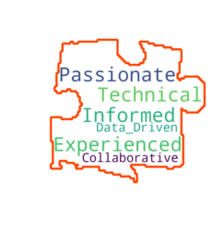

Why Spin and What Do I Bring to the Team
Spin has a proven record on its commitment to sustainability, safety, affordability, and science. The company’s values align with my goals to create a social impact.
Spin is part of the Ford family, with a long-standing history and expertise on transportation and technology.
Spin is riddled with Optimization challenges – I want to help solve these problems

Slide 5
Partnership is Key to Sustainability
Micro-mobility service providers require legal permits to operate
Prevents cities from being flooded with (unused) scooters
Legal permits are hard to obtain because 1) cost and 2) community resistance
Focus on developing relationship w/ partners to continue to expand and operate
Community Impact
Congestion and Littering
Safety
Convenience
Partners care about 1) compliance and 2) if the operator is maintaining ethical vehicle deployment
Operator’s commitment to provide equitable service, especially to essential services

Slide 6
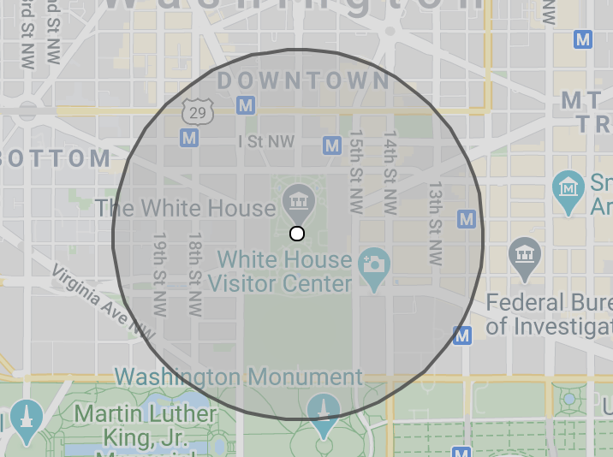



Balancing Coverage is the Key to success
“VPM” a.k.a. vehicles per mile
Definition: the number of vehicles per half-mile radius (or 1000 steps)
Too high causes congestion safety issues
Time
Weather
Too low causes poor user experience and lost of revenue
demand
Location
Traffic

Slide 7
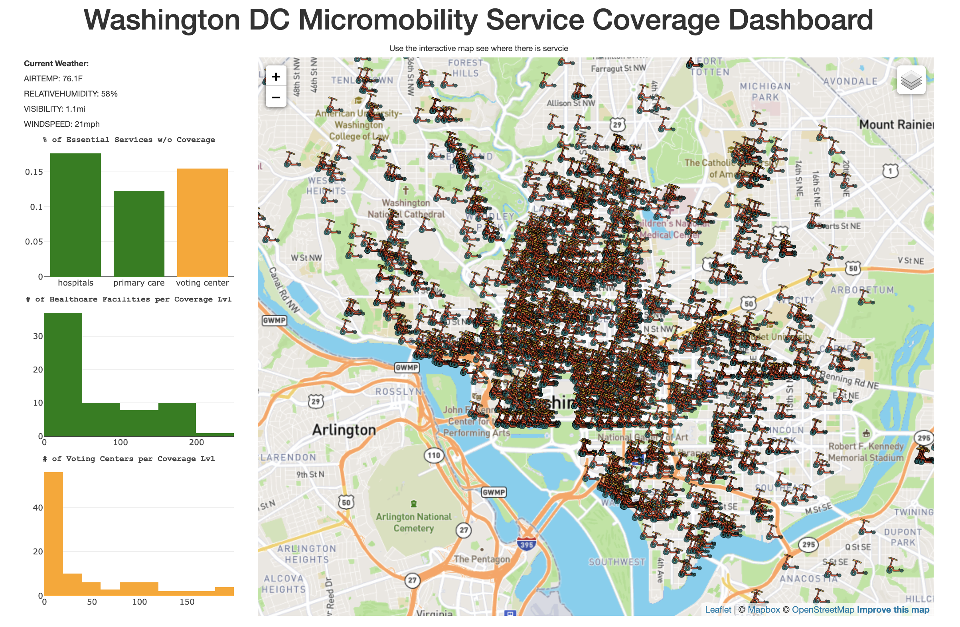
Operations Need Tools to Monitor Coverage

Slide 8
Dashboard Methodology
Publicly available APIs for Real-time data
Vehicle Availability
Places API – hours of operation
Traffic
Metro Stations
Police Incident Report
Open source technology that can be implemented in any active market
Powerful computing system to calculate distances with high throughput and low latency

Slide 9
The Tour
Visit and use it for yourself
https://dc-micro-mobo.herokuapp.com/index.html

Slide 10
Q&A & Future development
Coverage in more markets
Additional considerations for:
Reservations
Local Events
Data mine VPM history
Live stream on election day!

Slide 11
APPENDIX

Slide 12









Partnership is Key to Sustainability
Finance
User
Operations

Slide 13
More Testimonies
Testimony from Students
I really like how Kevin explains the class concepts and his explanations encourage me to do more research on my own and deepen my skill set.
Kevin did a great job on Saturday! The pace was slow enough for him to explain things in depth and gave the class time to digest what was being said. This allowed myself and other students to ask meaningful questions and created a much more interactive class. Great job
Thanks for all the encouragement on the projects and presentations.
Kevin is an awesome at explaining things and he made class very interesting. He has also a great personality and is always willing to help.
Kevin explained and demonstrated the class concepts very well.
kevin is great!
kevin is a damn saint
Kevin explained the subjects very well.
Kevin, the TAs, and the LAs are all awesome, always super helpful, and invest so much into our success--I truly appreciate it so much and I don't take it for granted. Thank you!
Kevin explains so well so I can understand the topic very well.
Could not have asked for a better or a more preferable instructor--Kevin is the best and is teaching us everything we want/need to know about data analytics and more. I truly praise him for his high-caliber skills in data science and in education. He is as bona fide in his role at DU as it gets. Thank you Kevin, for everything.
The instructor went above and beyond to help with homework. He set up separate sessions outside of class to help.

Slide 14

Kevin

Slide 15


